Slide 1

User Habit Unveiled
Marketing insights for strategic growth
Presented by : Daffa Arkananta
Last updated : December 12th,, 2023

Slide 2
Table of Contents
User Habit
Business Goals
The Story behind Bellabeat’s Data
Conclusion
Recommendations

Slide 3
What is our goal?

Slide 4
Objective
Identify user’s activities throughout smart devices to provide new marketing strategy.

Slide 5
The story behind the data

Slide 6
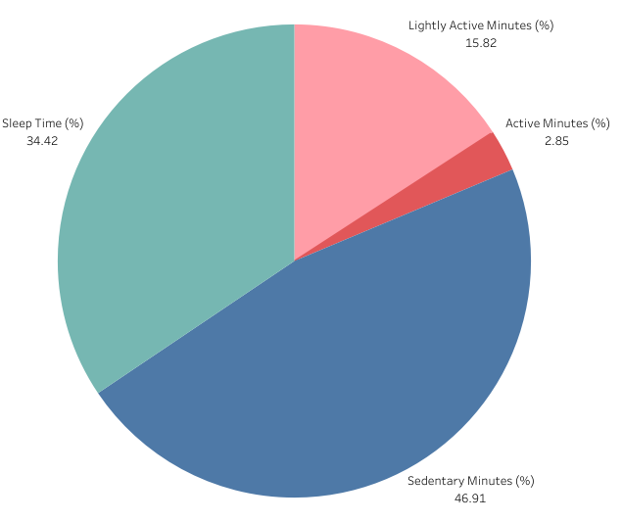
User Activities
User’s are using smart devices to track activities, such as sitting, walking, exercising, and sleeping.
On a daily average :
User spend around 11 hours (46.91%) of their time sitting or being inactive.
User spend around 4 and a half hours (18.67%) daily to exercise.
The remaining time, 8 and a half hours (34.42%), is spent for sleeping.
average user activities in a 1 day period

Slide 7
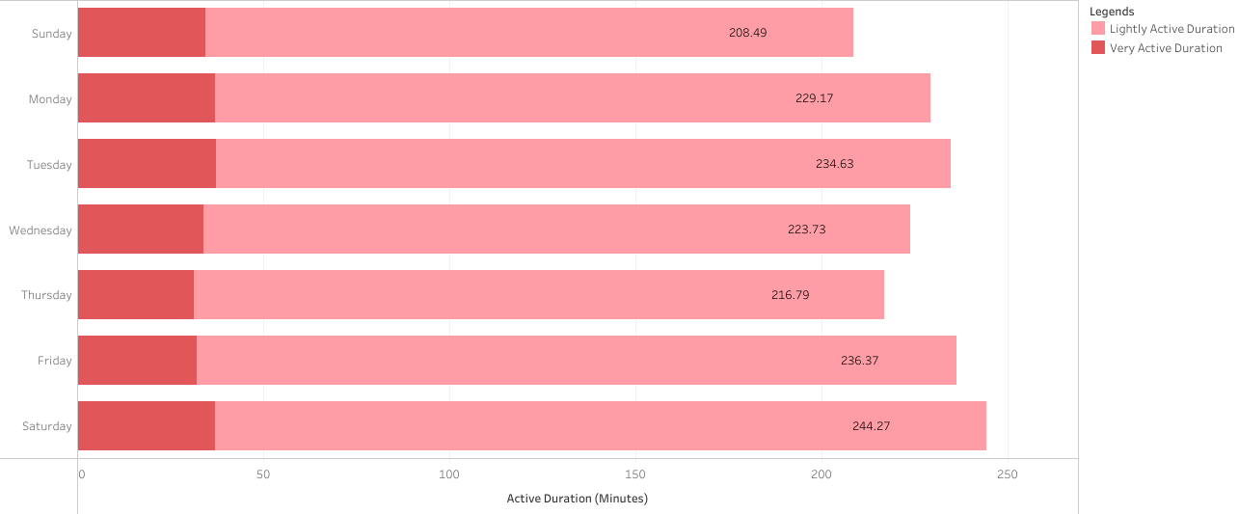
Active Day of Week
Saturday & Friday are the most active day of week.
Sunday & Thursday are the least active day of week
Average Active Duration by Day of Week

Slide 8
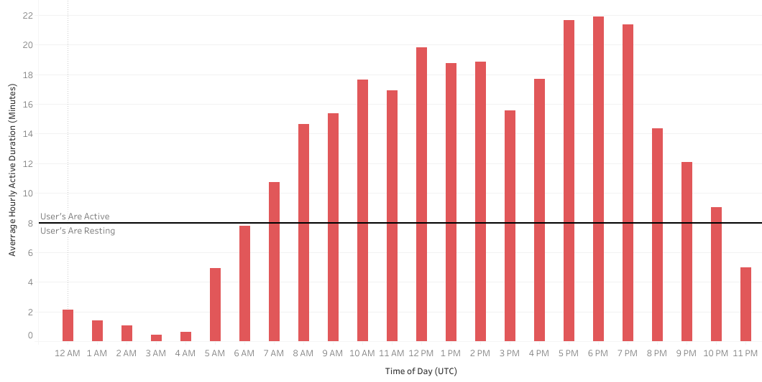
Active Time of Day
5 PM to 7 PM is when user’s are the most active
User’s are inactive or sleeping starting from 10 PM to 6 AM
Work Break
Morning Activities
Leisure Time

Slide 9
Conclusions

Slide 10
Conclusions
1
2
3
User’s daily activities are dominated by being inactive, sitting, or staying still.
Saturday is the most active day
while
Sunday is the least active day
User’s tend to be more active from 5 to 7 PM and rest or sleep from 10 PM to 6 AM

Slide 11
Recommendations

Slide 12
Recommendations
1
Categorizing user’s active rate from very active, active, moderately active, lightly active, and sedentary in order to make a more personalized app and ads from each user’s device
2
Displaying marketing ads on mobile phone at 3 PM where people are mostly on a break from work. Other options are leisure time at 9 PM.
3
Displaying marketing ads on busy streets at 6 to 8 AM and 5 to 7 PM when people are mostly moving to and/or from work with an ads frequency increase in Friday to prepare for Saturday activities.

Slide 13
Steps to be taken

Slide 14
Next Steps
1
Collect more data about regions and locations to estimate the busiest location in order to maximize marketing ads.
2
Build an AI model based on personalized user habit in order to make a more personalized app and make customer feel more engaged.
3
Adding more features for the app to better understand user activities, such as running, cycling, walking, or even swimming. The input could be manual by user or automated by detecting heartrate, movements, phone’s gyro sensor and GPS.

Slide 15
Thank You

